Slide 1
Challenges for healthcare Leaders of the Future World Health Leadership Network 7th December, 2023
John R Campion
MB BCh BAO MSc MA MRCPI
Gastroenterology Clinical Research Fellow, Mater Hospital Dublin
Royal College of Physicians in Ireland Quality Improvement Scholar in Residence 2023

Slide 3
My Leadership Journey
ASSOCIATION OF
MEDICAL STUDENTS
OF IRELAND
WASHINGTON
IRELAND
PROGRAM
NATIONAL DOCTORS
TRAINING AND PLANNING
SCHOLARSHIP
W.H.O. CONTROL OF
EPIDEMIC DISEASES UNIT
RCPI
QUALITY IMPROVEMENT
SCHOLAR IN RESIDENCE
LEAD NCHD
(CHIEF RESIDENT)

Slide 4
Challenge 1
The Challenge
Future clinical leaders are current busy clinicians
A Solution
Protected time for leadership development and training credit for leadership work

Slide 6
Challenge 2
The Challenge
Quality improvement is too important to be left to people
with ‘quality improvement’ in their job title.
Possible Solutions
Democratization of Quality Improvement
Distributed Leadership
Meaningful Patient Involvement

Slide 7
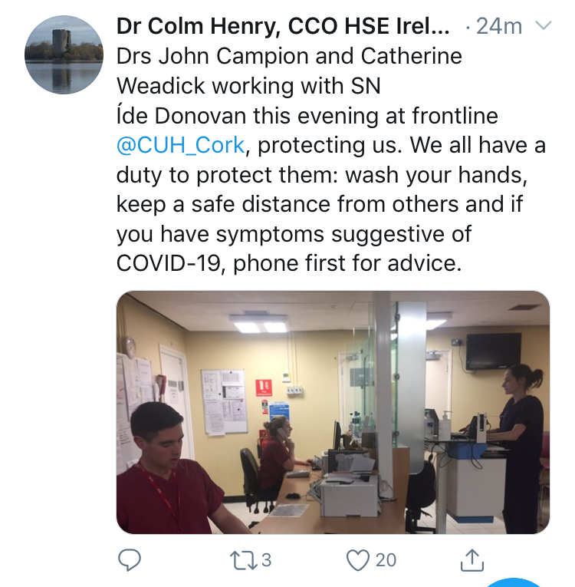
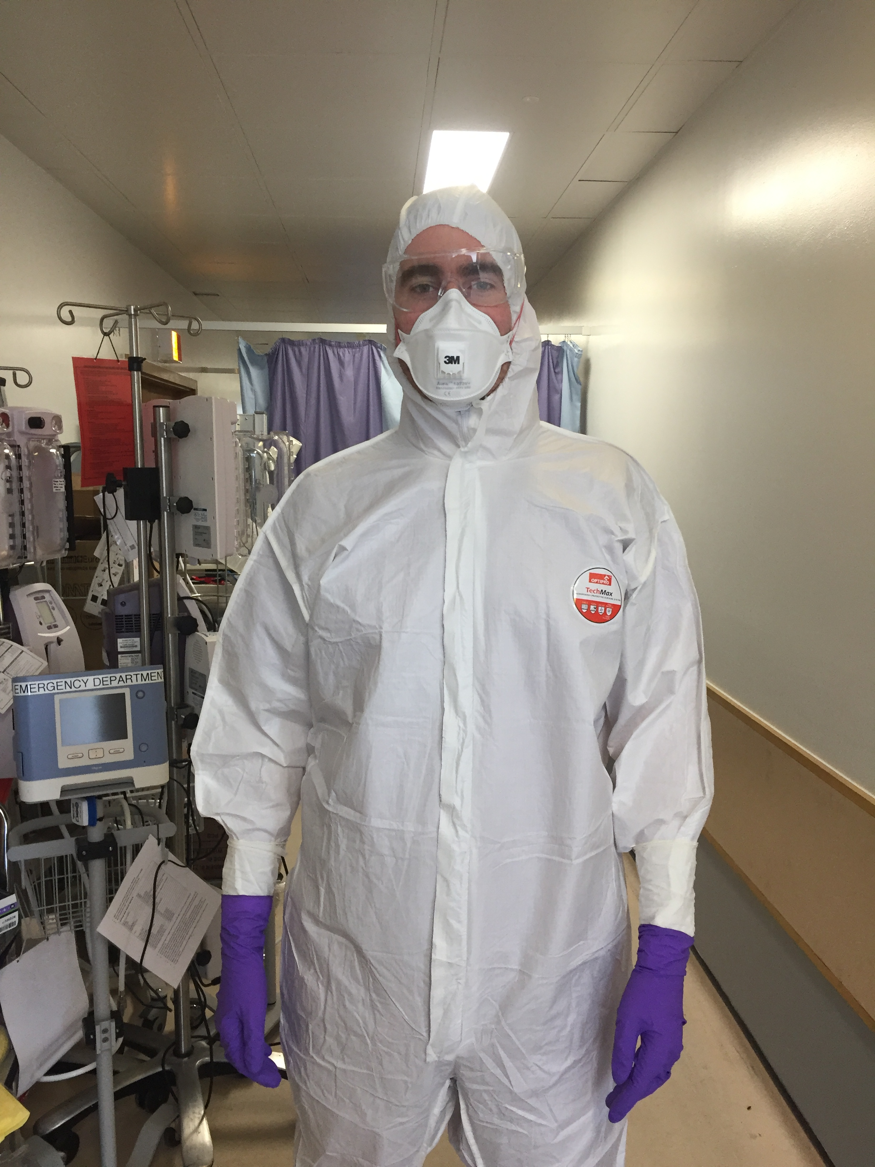

Slide 8
Challenge 3
The Challenge
Early-career healthcare professionals frequently operate in silos.
Possible Solutions
Interdisciplinary groups to encourage networked problem-solving and quality improvement
What Else?

Slide 9
Challenge 4
The Challenge
Early-career health professionals frequently have to move on from a hospital/clinic after a short period of time.
A Solution
Leadership and learning opportunities that follow the person

Slide 10
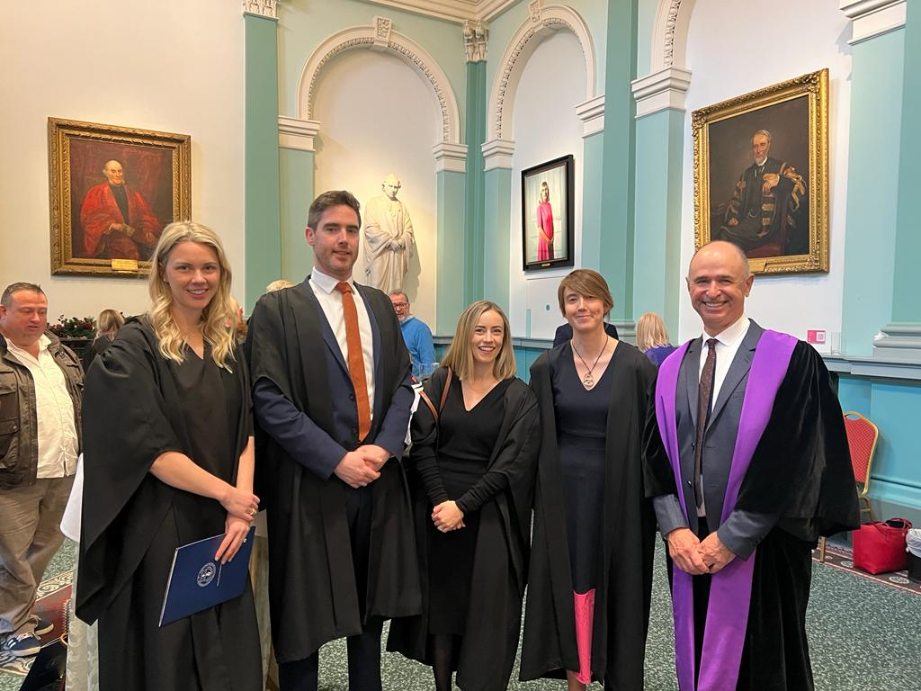
Royal College of Physicians of Ireland (RCPI) Quality Improvement Scholar in Residence Programme
One-year programme
Small group of senior doctors-in-training with an interest in leadership and quality improvement to develop clinical leadership skills and quality improvement knowledge.
Expert support and bespoke training to promote the development of skills and knowledge enabling them to provide quality improvement and clinical leadership.
Opportunities to lead quality improvement and contribute to QI literature.

Slide 12
Challenge 5
Technology-centric development of
artificial intelligence applications in healthcare
A Solution:
Prioritise study of human- AI interaction and human factors
in research of any new AI applications in healthcare

Slide 13
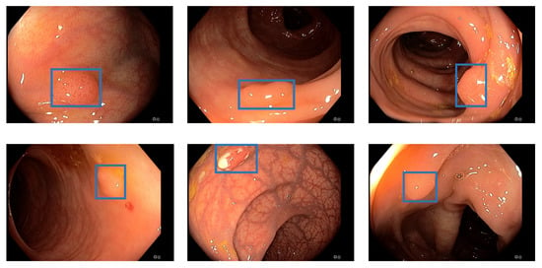

Slide 14
Summary
How can my healthcare system support future leaders and meet challenges such as
Top-down leadership
Silos in training and working
Short duration of employment in each workplace
How can I empower future leaders to be drivers rather than passengers in development of healthcare AI?

