Slide 1
Why climate change really matters in healthcare
Richard Smith
Chair, UKHACC
Former editor, BMJ

Slide 2
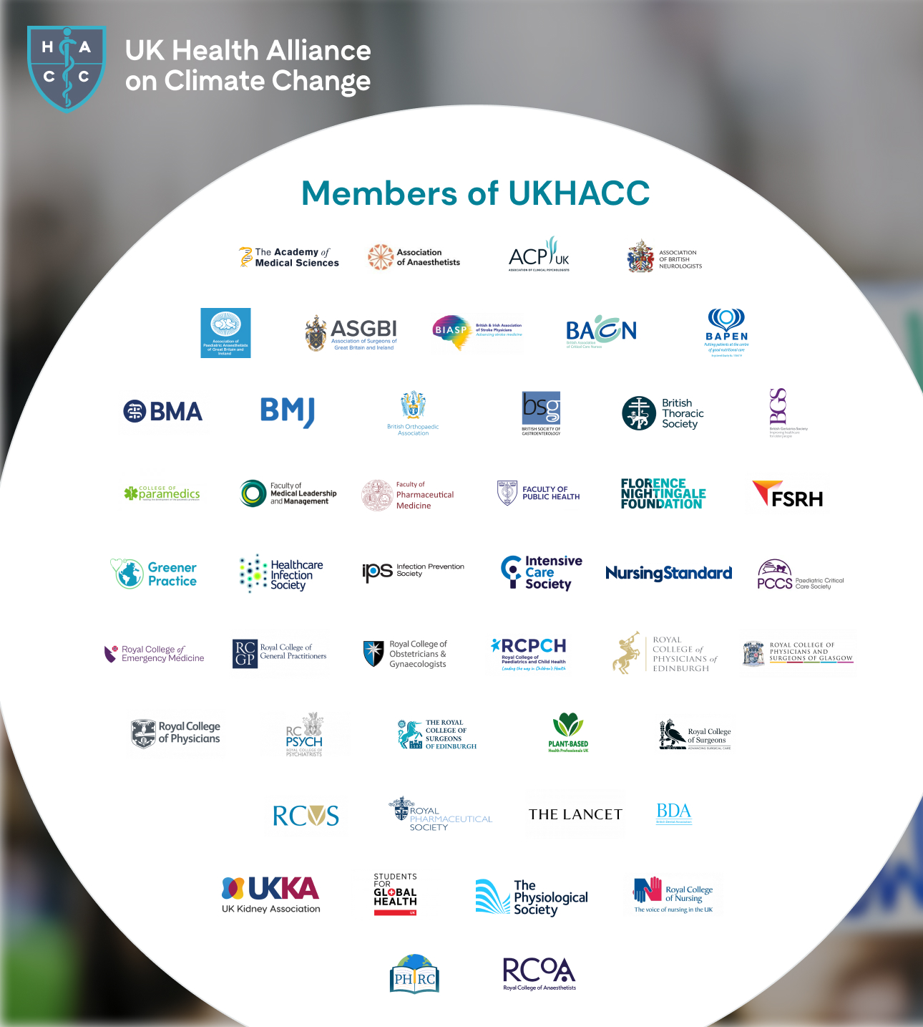
UK Health Alliance on Climate Change: 48 members; our members’ members number over a million health professionals
We work TOGETHER to mitigate the effects of the planetary crisis, encourage adaptation, and emphasise the benefits to health of the changes we need to make
Health professionals need to be more prominent in the debate
We work as well to support the NHS reach net zero

Slide 4
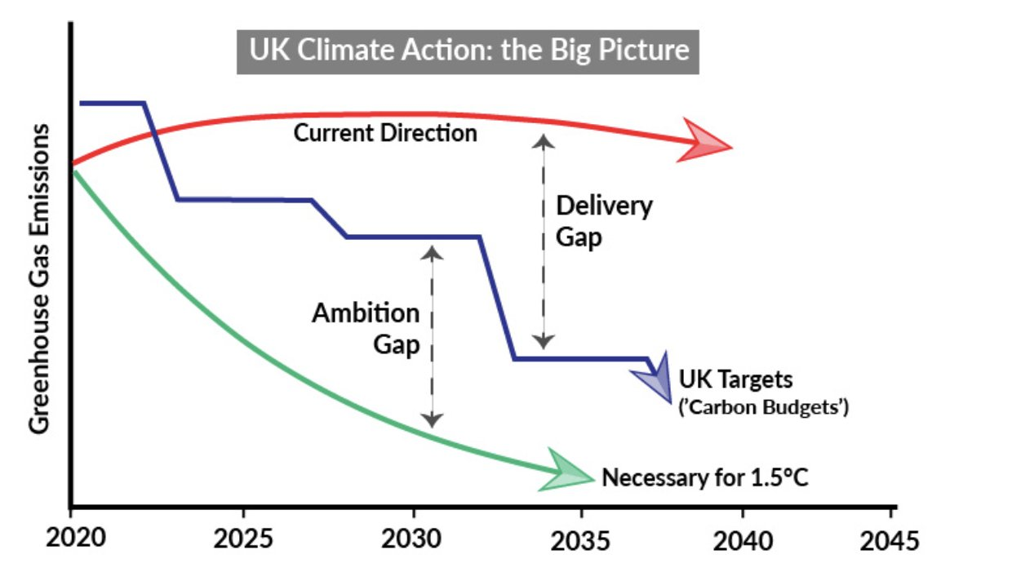

Slide 5
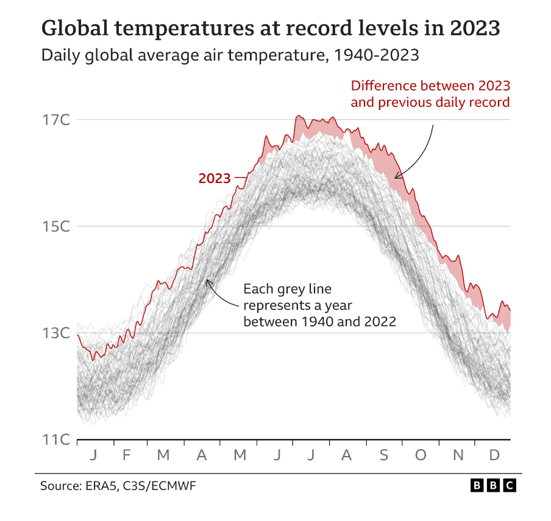

Slide 6
Climate change is THE major threat to global health WHO
Air pollution
Violent storms
Floods and wildfires
Heat waves
Mental health damage
Extension of infectious disease, pandemics
Desertification, deforestation, food shortages
Water shortages
Forced migration
War

Slide 8
How best to respond?

Slide 9
A response is needed at every level
Global
National
Regional/city
Health system/NHS
Organisation/members
Individual—professional and personal

Slide 10
Where healthcare professionals are at in the UK
Universal awareness | Variable awareness
Climate change is real and happening now | Urgency of need to transform society and risks if we don’t
Direct impact of climate change | Connection with health/healthcare/health priorities
Areas of action that can be taken to reduce personal carbon footprint | Connection with clinical role

Slide 12
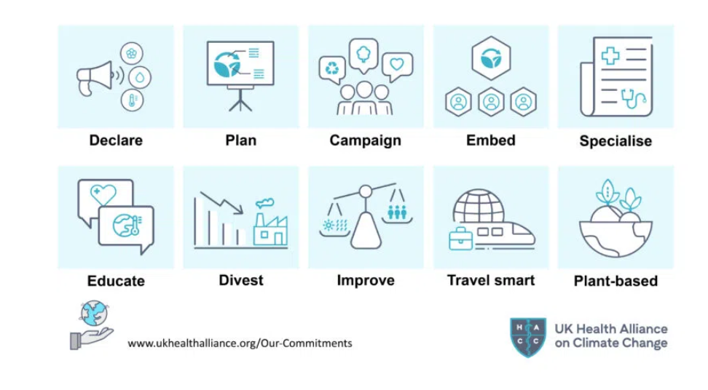
The 10 commitments of our members

Slide 13
NHS England net-zero targets written into law
Emissions controlled directly (NHS Carbon Footprint)
Net zero by 2040
An 80% reduction by 2028 to 2032
Emissions NHS can influence (NHS Carbon Footprint Plus)
Net zero by 2045
An 80% reduction by 2036 to 2039

Slide 14
Health system response: four figures
Globally, if healthcare were a country it would be the fifth largest emitter on the planet
Health care emits more greenhouse gases than aviation and shipping combined
NHS accounts for 5% of UK carbon emissions
One in 20 vehicles on the road in the UK is related to the NHS

Slide 15
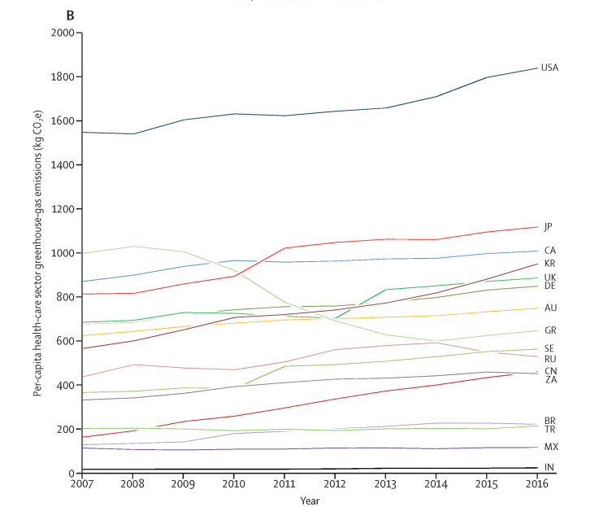
Carbon emissions from most health care systems are rising

Slide 16
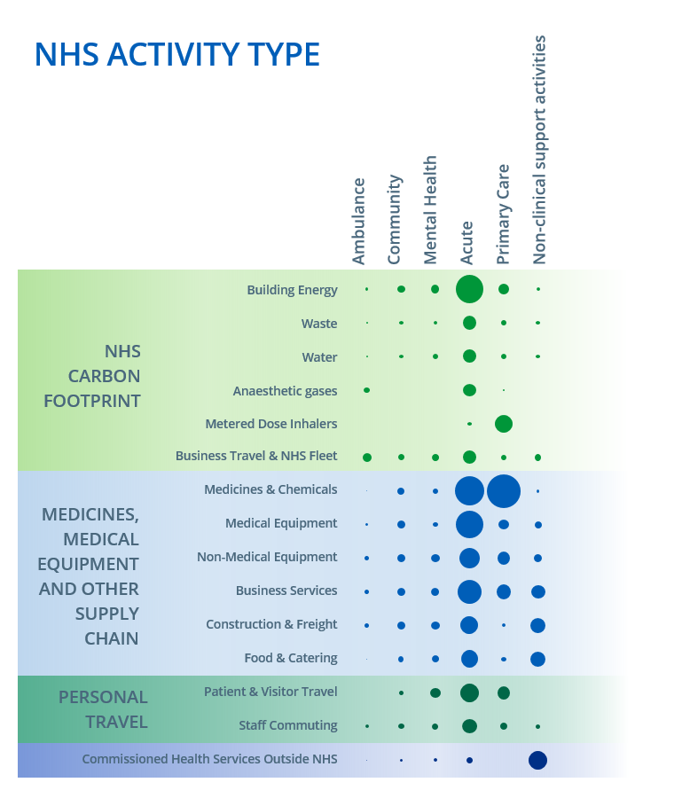
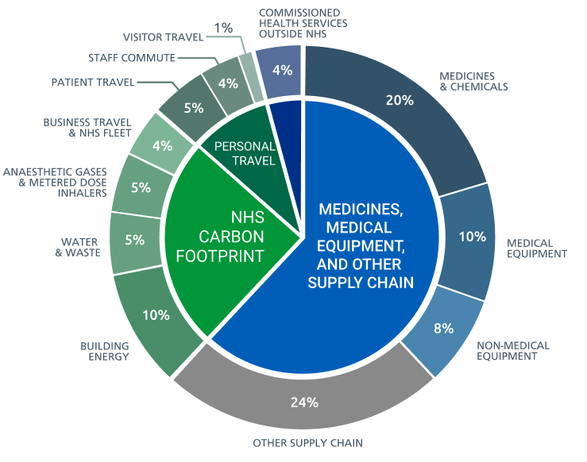
The Carbon Footprint of the NHS

Slide 17
The NHS Carbon Footprint Plus
Many interventions needed
Prevention and reducing inequalities
Anaesthetic gases and inhalers
Digital pathway redesign
Research, innovation sequestering
Must work with suppliers
Nobody knows what a net-zero health system looks like

Slide 18
Is your organisation serious about reaching net-zero? A checklist
Carbon footprint measured
Detailed, published plan with annual targets
Annual audited public reporting of progress
Commitment from the board with monthly review
One of the priorities of the chief executive
A chief sustainability officer
Staff
Funding

Slide 19
Sustainable clinical practice
Secondary drivers
Reduce carbon without reducing health
Reduce activity
Prevention
Self care
Reduce carbon intensity
Low carbon alternatives
Lean pathways
Sustainable estates
Primary driver
Outcome needed
Sustainable clinical practice
Primary driver
Infrastructure & process
CENTRE for
SUSTAINABLE
HEALTHCARE
Mortimer-F. The Sustainable Physician
Clinical Medicine 2010, Vol 10, No 2: 110–11

Slide 20
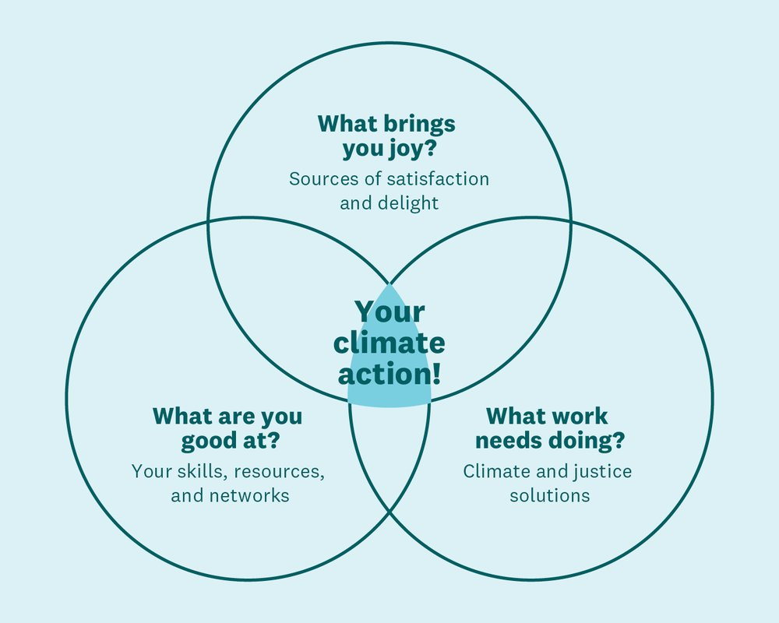

Slide 21
What can you do now?
Move
Move better: Fly less: ideally not at all… drive less, walk and cycle more
Eat
Eat better: Move from high carbon diet > low carbon diet
Buy
Buy better: Use your money – change your bank; divest from fossil fuels; invest in sustainable goods and services…
Vote
Vote better: Only ever vote for candidates for anything who are serious about climate change
Campaign
Campaign better—join organisations, make political statements….
Talk
Talk better: Talk about ecological degradation as a health issue rather than an environmental issue (…and listen better)

