Slide 1
Is 2019 the year for
your new job?
Kate Cooper
Head of Research, Policy & Standards
Juliet Kampasi
Events & Research Coordinator

Slide 2
New Year, New Job
1 in 3 respondents are likely to change their job this year

Slide 3
New Year, New Job
74% believe the New Year leaves them feeling like they can achieve more in their careers
1 in 3 respondents are likely to change their job this year

Slide 4
Top reasons for people changing jobs in 2019

Slide 5
Top reasons for people changing jobs in 2019
Based on age
18-30
31-40
41-50
51-60
26% You are no longer interested in the work
33% Your organisation’s values don’t align with yours
32% You want more flexible working arrangements
30% You are looking to start your own business
29%You don’t get on with your co-workers
42% You don’t get on with your manager
33% You re too young to sit it out until you retire
30% There are no opportunities for training and development
43% You want to change to full or part time
34% Your organisation is restructuring or reorganising
33% You don’t get on with your manager

Slide 6
Key factors that affect respondents’ decisions to stay or leave their job

Slide 7
Key factors that affect respondents’ decisions to stay in their job
Based on age
31-40
41-50
51-60
33% You had a mentor
28% You had options for flexible working
36% You had a mentor
32% Your work was more challenging
30% You had opportunities for training and development
29% You felt a greater sense of belonging

Slide 8
Key factors that affect respondents’ decisions to stay in their job
Based on gender
You felt a greater sense of belonging
You had options for flexible working
Your physical or mental health needs were better accommodated
You had a mentor
36%
60%
32%
64%
36%
60%
48%
51%

Slide 9
Dimensions of Leadership
The Institute of Leadership & Management is the professional membership body for leaders, managers, coaches and mentors. We understand leadership to have many strands and be multi-dimensional.
These dimensions are also the values of the Institute

Slide 10
Where to start

Slide 11
It will take time

Slide 12
Rehearse the reasons you’re leaving your present job

Slide 13
LinkedIn is vital
Recruiters, let them know you’re available
People you may know or be introduced to at any prospective employers
LinkedIn Learning for updating

Slide 14
Only apply for jobs you want

Slide 15
Remember your CV is a living document

Slide 16
Embrace the idea of transferable skills
Transferable skills, also known as “portable skills,” are qualities that can be transferred from one job to another. You likely already possess many transferable skills employers want, like organization or strong communication. You can strengthen those skills and develop new ones that employers value across industries and jobs.
https://www.indeed.com/career-advice/resumes-cover-letters/transferable-skills
Communication
Dependability
Teamwork
Organisation
Adaptability
Leadership
Technological literacy

Slide 17
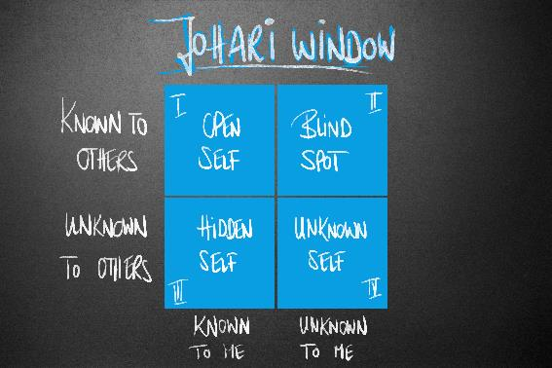
Ask a colleague to list your strengths

Slide 18
Enroll on at least one MOOC

Slide 19
Submit applications in parallel

Slide 20
Never burn your bridges

Slide 21
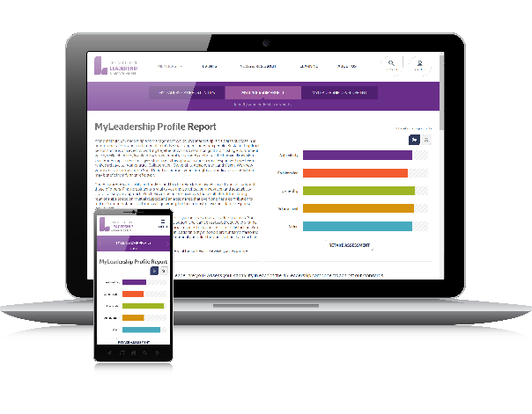
Have you tried MyLeadership?
MyLeadership
ASSESS YOUR CAPABILITY
Self-Awareness
http://bit.ly/SelfAw

Slide 22
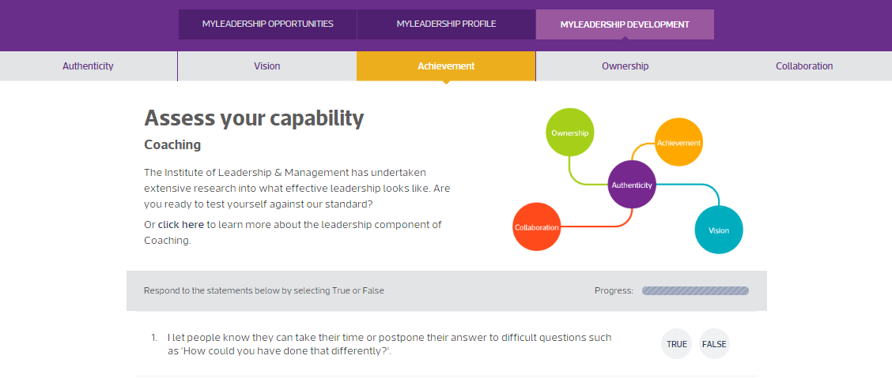
Have you tried MyLeadership?

Slide 23
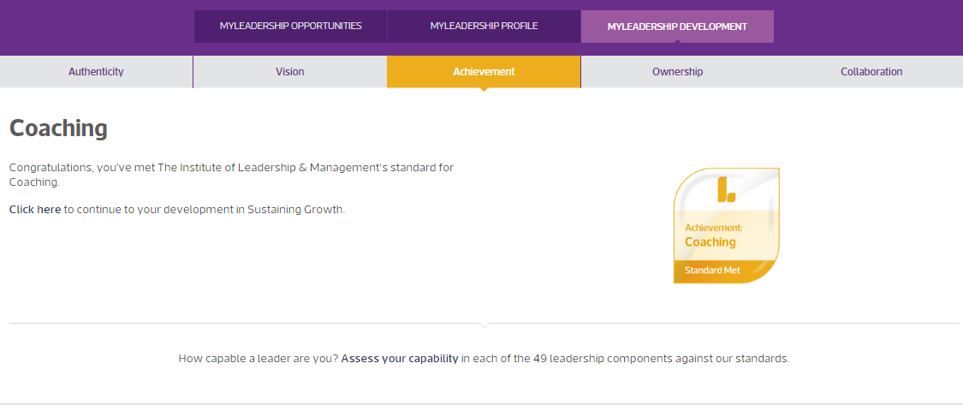
Have you tried MyLeadership?

Slide 24
Our Journal ‘Edge’
Free to download from https://issuu.com/revistabibliodiversidad/docs/edge_digital

Slide 25
Thank you
We’re on a mission to inspire great leadership. Everywhere
Download our research reports
www.institutelm.com/research-news/research

