Slide 1
Beyond the bonus:
Driving employee performance
Notes:
This presentation is for ILM centres and tutors. It covers research carried out by ILM in the summer of 2013. Available at: https://www.i-l-m.com/Why-ILM/Research-reports/Beyond-the-bonus

Slide 2
Methodology
Aims:
Employee perceptions (jobs, training, performance & reward)
Manager v Employee perceptions
Surveys:
1018 employees (non managerial)
1091 managers (ILM members)
Both broadly representative, UK by age, sex, sector
Notes:
The aims of the research were to explore:
how employees felt about their jobs, their managers and their employers, their access to training, the rewards they get for their work and how their performances was assessed, and how important these factors were to them
managers’ perceptions of their employees’ views on these topics, to determine just how well their perceptions aligned with what employees told us.
Methodology:
Following initial desk research to review the available literature, two online surveys were designed to reflect the dominant concepts and practices that influence managerial behaviour and employment practices in the UK. It was tested (piloted) with a small group of respondents before being completed by two separate samples:
1018 non-managerial employees were selected (from a Toluna, market research agency, Respondent Panel) to be broadly representative of the UK workforce, in terms of age, sex and employment sector.
1,091 managers drawn from ILM’s membership. This latter also broadly reflected the profile of UK managers, in terms of demographics and sectoral employment. The fieldwork was undertaken during July 2013.
Most of the questions were closed, rating scales (or multiple choice), but respondents had the opportunity to add additional information to some, and two questions were designed as open questions, to generate responses in both employees’ and managers’ own words. These were subsequently coded and collated to identify common responses.
The survey was conducted in line with the Market Research Society (MRS) Code of Conduct. All responses were anonymous but respondents were asked if they would be willing to be contacted for PR purposes, and were also incentivised to take part in the survey.

Slide 3
Employee Motivation
Overall level:
Highly 16%
Fairly 55%
Not that well 14%
Lacking 8%
Increase motivation by improving:
Working environment 31%
Pay & rewards 24%
Work conditions, kit 13%
Communication 6%
Confidence in future & job stability 4%
staff (more or better) 4%
Notes:
Most (over two thirds) of employees are highly or fairly well motivated but over a fifth (22%) responded that they were either not that well motivated or quite lacking in motivation in their job and not caring what their employer is trying to achieve or how they can contribute. (Nearly 8% again said that they didn’t know or want to say.)
ILM also asked the sample of employees for one thing that would motivate them to do more . Nearly a third (31%) suggested improving working environment through better treatment and more praise – feeling more valued. Almost a quarter suggested better pay and rewards. The next most popular suggestion was to improve operational systems and equipment.
These responses show that better working environments, support/feedback from their manager and adequate pay and benefits are both highly motivating and increasingly desired by employees. They also show that there is work still to do in improving interpersonal skills in management in order to fulfil this need for better communication. Managers who understand and utilise these tools to motivate will be able to get the best out of their workforce and produce a happier, more productive environment.

Slide 4
Motivators
Intrinsic: role & individual
Extrinsic: recognition of output/ outcomes
Notes:
There are two types of motivators – Intrinsic and Extrinsic.
Intrinsic: relates to the individual attitudes and expectations of the employee about the role, the work and the people they work with. Intrinsically motivated work provides rewards by itself, for example the pleasure in achieving a task.
Extrinsic: relates to factors applied from elsewhere outside of the individual and often conditional on performance or output – if you do this, then you will get that. Extrinsic motivators include financial incentives and public awards or recognition.

Slide 5
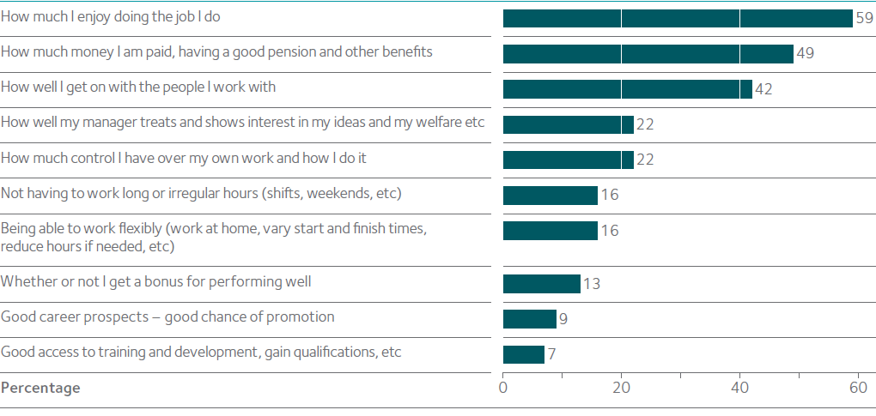
Importance of motivating factors
Notes:
Employees were asked to select the three most important factors to them from the list of ten.
Providing employees with an enjoyable job is the most effective way to motivate staff, with a competitive base salary and pension following second. The third most important factor is how well employees get on with the people they work with. These three factors lead by a sizeable margin.
(NB: These figures should total to 300% as each respondent could choose three items (factors); however some selected less than this, so the total is 255%.)

Slide 6
Value of money
Base salary: important motivator
Other financial incentives: much less
Common - 43% in organisations using them
Impact of financial incentives:
V. important 31%
Pretty important 25%
Quite important 20%
Not that important 18%
Not al all important 16%
Notes:
Base salary is listed as the second most important motivator (49% employees chose it as one of their top three factors). But other financial incentives are much less so: performance related bonuses ranks as the 8th most important motivator (only 13% selected it in their top three). Yet the use of financial incentives is commonly used by employers, 43% of respondents indicated that their employer uses some form of financial bonus. Personal performance-related bonuses are the most common reward scheme in operation (13%), with bonuses related to business performance (10%) and performance related pay increments (6%) the next most popular.
This varies by sex and sector. Over half of men (54%) and one third of women (33%) indicated that financial incentives are available at their workplace in some form, indicating that men are significantly more likely to receive a bonus than women. Far more private sector employers offer financial incentives (41%) than employers in the third (21%) or public sector (22%).
When asked about the impact of these financial incentives, employees were divided, with 46% saying they are ‘very’ or ‘pretty’ important to them; 34% saying they are ‘unimportant’, and 20% falling somewhere in the middle. Only the 31% who said it was very important, were continually aware of the financial incentive on offer and their need to put in that extra effort to achieve it. The rest only remembered from time to time or had dismissed the incentives as unreachable.

Slide 7
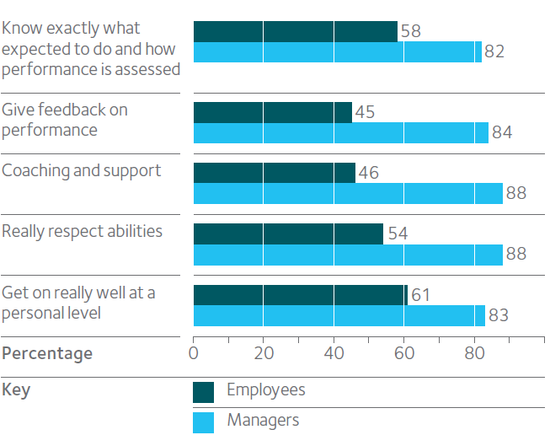
Employee & manager relationship
Notes:
The message from this graph is clear – managers think they are performing better in these areas than employees do. There is a word of methodological warning here. The employees and managers are from separate samples and are not talking directly about each other (the managers in the sample are not managing the employees in the sample). Also the managers are drawn from the ILM membership, who we would logically expect to be more interested in performing well as managers. Hence in this respect our sample of managers may be slightly less representative of the UK population of managers as a whole and the two sets of responses may not be so contradictory.
Nevertheless (even if the rest of the manager population is as diligent about this area of management as our members) managers can probably not over do these things. Even if it is obvious to the individual manager, it may not be so obvious to their individual reports and those they are managing. So as a manager you can never really do enough of the ‘five fundamentals’ of good management: coaching, giving feedback, listening, recognising success and performance management.

Slide 8
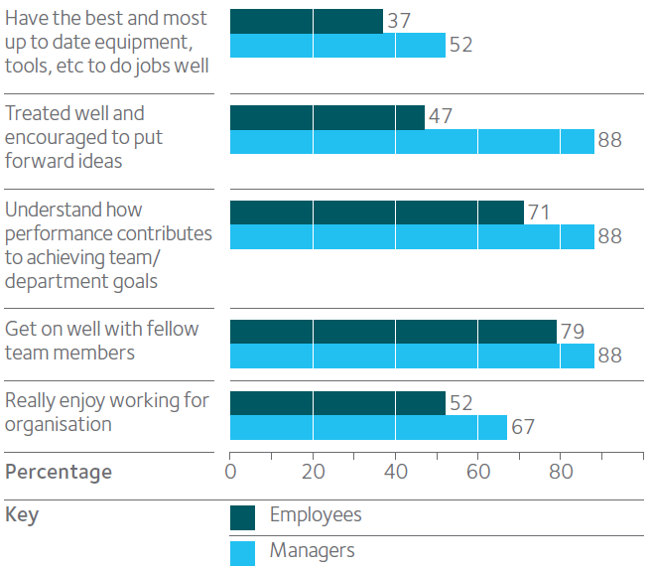
… and attitudes to work
Notes:
Again (and bearing in mind the same methodological caveat) managers are significantly and consistently more positive, in their perceptions of their direct reports, than the employees themselves. Again this is important as these relate to the intrinsic motivational factors (identified earlier) that generally outweigh the extrinsic motivational factors.

Slide 9
Men compared to women
Women more highly motivated than men
Women more motivated by:
Job enjoyment
Flexible working
Interest by manager
Getting on with colleagues
Men more motivated by:
Base pay
Bonus
Career prospects
Notes:
Overall, women are more highly motivated than men. They are significantly more likely to report that they are fairly well motivated. Conversely men are significantly more likely to report that they are either not that well motivated or quite lacking in motivation. While the relative rankings of motivational factors by women and men are similar there are some differences. The biggest are job enjoyment for women and base salary, pension and benefits for men. There is a smaller difference by gender for the other factors listed.

Slide 10
Part-time compared to full-time
Part-time staff are more highly motivated
Full-time:
Less likely to get coaching & support
Less likely to respect manager’s ability
More motivated by pay and bonus
Part-time:
Less likely to find job v. stressful
Earn less, pro rata
More likely to say they work hard
More likely to be satisfied by job itself
Notes:
Part-time respondents were more likely to report that they were highly or fairly motivated than full-time staff (76% part-time staff compared to 68% full-time staff). This is even though part-time staff tend to earn less, pro rata, on average than their full-time colleagues. While both groups agree that they get on really well with their line manager on a personal level (61% agreeing, 9% part-time staff disagreeing, 11% full-time staff disagreeing), full-time staff don’t feel as supported by their line manager as their part-time counterparts. Amongst full-time respondents there was only 21% net agreement that they got the coaching and support they needed to do their job well, compared to 32% net agreement ((Strongly Agree + Agree) – (Disagree + Strongly Disagree)) from part-time respondents. Similarly there was only 18% net agreement that amongst full-time recipients that they regularly received feedback on their performance from their line manager, in contrast to 25% from part-time respondents. Full-time staff were less likely to respect their line manager’s ability as a manager (33% net agreement compared to 44% for part-time respondents). This is even though part-time staff are slightly less likely to know exactly what they are expected to do and how their manager assesses their performance (39% net agreement for part-time compared to 45% for full-time).
While full-time staff are more motivated by financial reward (they are half as likely to say that it was not all important to them at, 13% compared to 27% for part-time staff), part-time staff are more motivated by intrinsic factors of the job itself. There was 63% net agreement from part-time staff that they get ‘enormous satisfaction from doing my job well’ compared to only 53% of full-time staff. 81% of part-time staff agreed that they work as hard as possible to do the best job they can, compared to 73% of full-time staff.
These figures and others in the report demonstrate the huge hidden value of part-time workers. They provide a rich and engaged pool of talent for employers, cost the organisation less (pro rata) than full time staff, are more positive about their work and generally work harder for their employer. The research indicates that increasing the number of job share or part time roles in an organisation could add value for employers and ensure a more positive, happy workforce, with more rewarding roles for employees.
In our sample, part-time employees were most likely to be female, reflecting the general make up of part-time employees in the workforce. However this divide is beginning to become smaller, with a consistent growth in the proportion of men working part time, up from 7% to 13% in the last 20 years. Results from our previous research, Flexible Working: Goodbye Nine to Five, reflected this trend, with 38% of managers saying men in their team were working part time compared to 63% of female team members.

Slide 11
Motivation: employee archetypes
Career climbers:
Career prospects over financial reward
Financially focused:
Performance related bonus
Flexi-workers:
Prioritise flexible working
Sociable workers:
Colleagues & job
Notes:
Through our research we identified four employee archetypes:
Career Climbers are keen to advance rapidly, and are hungry for new skills. They prioritise training, development and experiences that will enhance their career prospects over financial reward. They are also likely to be under 35 and hard workers.
Financially Focused employees choose performance related bonuses as their single most motivating factor and place the greatest emphasis on financial rewards and the importance of money. They’re also least likely to enjoy their jobs and tend not to have warm feelings for their employer or their manager. Getting on with their colleagues and enjoying their job is significantly less important to them than financial reward. They are most likely to be male and currently working full time for their employer.
For Flexible Workers being able to work flexibly, from home or with varied start and finish times is important. They’re likely to have been with their employer for a slightly above average length of time, be more qualified than the average employee and get on well with their manager. They’re also likely to be working part-time for their current employer. Other archetypes often change into Flexi-workers later in their career.
Sociable Workers are most motivated by getting on well with the people they work with, the Sociable Worker is on a below average salary, respects their manager, works hard and enjoys their job, which gives them great satisfaction. They’re least likely to say they work because they need the money – they’re in it for the love.

Slide 12
Employee archetypes: motivators
Career climbers:
Training & development
Financially focused:
Financial incentives, (extrinsic motivators)
Flexi-workers:
Flexible hours/location, challenging & rewarding jobs
Sociable workers:
Regular feedback, coaching styles, positive working environment
Notes:
Career Climbers:
Access to training and development is the most effective motivator for Career Climbers when starting out in management roles, as they are keen to make the best of themselves. Employers can motivate the Career Climber by providing continuous access to training and opportunities for development from the day they join. Pay attention to your Career Climbers by giving them access to both structured development and on the job learning through challenging projects and tasks.
Financially Focused:
Certain roles with more transactional relationships between employer and employee are more likely to attract those who are Financially Focused, which can be positive if both employer and employee are happy with this arrangement. Financially Focused employees are often at the higher end of the pay scale in jobs with long hours and high levels of stress, or in more mundane, manual roles based on output of product where financial reward for performance becomes important. Financial incentives do work here, but emphasis on intrinsic motivators could improve the workplace experience for both the employee and the employer.
Flexible Workers:
Respond well to their employers investing in them and prioritise flexible working hours and location as a key motivator, so employers with a smart, forward thinking attitude to flexible working will be able to attract and retain this highly skilled and highly motivated pool of talent. Offering challenging and rewarding part time jobs will help attract them to a company, and being prepared to adapt to any requests for flexible working will keep existing employees engaged and motivated.
Sociable Workers:
Building positive and supportive relationships at work is very important to the Sociable Worker, so giving regular feedback, creating a positive working environment and using coaching styles are a great way to motivate these types of employees. A strong team dynamic and regular opportunities to interact with other employees can ensure they feel connected and engaged with the team and the wider organisation.

Slide 13
Performance appraisals don’t work
61% employees’ workplaces had an appraisal system…
… of those, appraisals:
Inform tasks people perform (68%)
Contribute to a bonus (33%)
Lead to promotion (19%)
Quarter of employees: manager poor at appraisals
11% employees: appraisals are irrelevant
Notes:
While performance appraisals are common – nearly two thirds (61%) of employees’ workplaces had an appraisal system – employees generally don’t see them as effective motivators.
The most common effect of appraisals is a change in the typical tasks people perform (68%), with a third (33%) saying their appraisal rating contributes to a bonus of some kind and 19% saying appraisals have led to promotion.
A quarter of respondents (25%) think their appraisals are often performed poorly by their manager, with 14% saying their manager tells them how they are performing and gives a rating and 11% saying that while they complete their appraisals both parties feel it is irrelevant.
Appraisals seem to be most ineffective in driving the performance of female employees. Women are more likely to give examples of poor practice in the appraisal process (29%) than men (21%). In contrast, men were more likely to say the appraisal process had a bigger impact on their careers, with 40% of men saying appraisals impact their financial reward compared to 26% of women and 24% saying they lead to promotion compared to 15% of women.
Used correctly, appraisal systems can be an effective way to drive performance. But our research indicates that many organisations are still performing poorly in assessing performance in this way. Better linking of individual SMART objectives with performance reviews, more regular meetings to assess performance rather than ‘once a year’ catch ups and better training for managers on how to use appraisals to develop staff could all help to increase the effectiveness of performance management.

Slide 14
Conclusion
Financial incentives are relatively ineffective motivators for most staff. Instead, improving the workplace and developing management relationships are more likely to lead to effective and well motivated teams.
Notes:
This research leads ILM to conclude that although performance related financial incentives are fairly common, they are only effective for a minority of staff. Instead efforts to promote a positive working environment and develop the management relationships between managers and their report are likely to be more effective and engage the majority of staff.

Slide 15
Recommendations
Job enrichment
Base pay, not bonus
Embrace part-time
Develop interpersonal skills

Slide 16
Job enrichment
Job enjoyment top motivator
Job design & team structure
Colleague interaction
Autonomy (chance to innovate)
Coaching
Notes:
Employees indicated that enjoyment of their job was the single most important factor in motivating them to perform in the workplace. Whether someone likes what they do is influenced by a variety of factors, but well-considered job design and the structure of a team can have a huge impact on how motivated an employee feels. Allowing employees to have autonomy in a role (important to 22% of respondents), frequent interaction with other colleagues and a chance to innovate can all improve their sense of job enjoyment and increase their level of motivation. Training managers to motivate staff and create an atmosphere where they are listened to, coached and given autonomy to perform can all impact on how much an employee enjoys their work.

Slide 17
Base pay, not bonus
Fair base salary, benefits, pension
Improve basic enjoyment of role
Notes:
While performance-related bonuses were largely ineffective, a fair financial package (base salary, benefits and pension scheme) was highly valued by employees and ranked as an important motivator. Instead of costly and ineffective bonus schemes, the research shows that increasing base salaries and investing in improving an employee’s basic enjoyment of their role would be more effective ways of improving performance. Non-financial recognition and reward, improved office environments, team and company away days and schemes that encourage innovation and creative thinking are all more effective drivers of focus, effort and commitment.

Slide 18
Embrace part-time
Retains talented staff addressing work/life balance
Change default assumption: role = full time post
Notes:
Part-time workers in this research were more positive, motivated and engaged with their teams than their full time counterparts. A growing proportion of the UK workforce are employed in part-time roles, and organisations that employ part-time staff are reaping the benefits of a talented and engaged workforce. Employers should not be afraid of creating a ‘decimal point’ in their workforce, designing and recruiting for jobs that fall outside the traditional 40-hour a week standard. Embracing a more positive attitude to flexible working will also help employers retain talented staff who move from one stage of their career to the next and whose work preferences change.

Slide 19
Develop interpersonal skills
Can’t overdo basics of good management
Train managers to:
Use coaching styles
Give effective feedback
Encourage employee ideas
Rethink appraisals
Notes:
How well employees got on with their managers, how well they felt they were treated and valued and the sense of control they feel over their work were all important to employees in improving their sense of motivation. Our results show that managers can never do enough of the basics of good management, so developing your managers’ people management skills is essential in improving and maintaining motivation. Train managers to use coaching styles, give effective feedback and encourage a culture of innovation where employees feel free to contribute ideas. Appraisals were also identified as a weak point in the research, with many employees giving examples of poor practice. The challenge facing HR and L&D teams is to design and implement an effective appraisal process that clearly links performance with review and to ensure managers are trained in administering it effectively. Without these, appraisals will continue to have little impact on motivation and performance.

Slide 20
Any questions? The future is already here – it’s just not evenly distributed (William Gibson, 2003)

Slide 21
Thank you
www.i-l-m.com/Why-ILM/Research-reports/Beyond-the-bonus

